Slide 1
PROJECT NAME : SNAKE GAME
CONTRIBUTERS
R.SIVANJITH REDDY
B.AVINASH
V.TIRUMALA

Slide 2
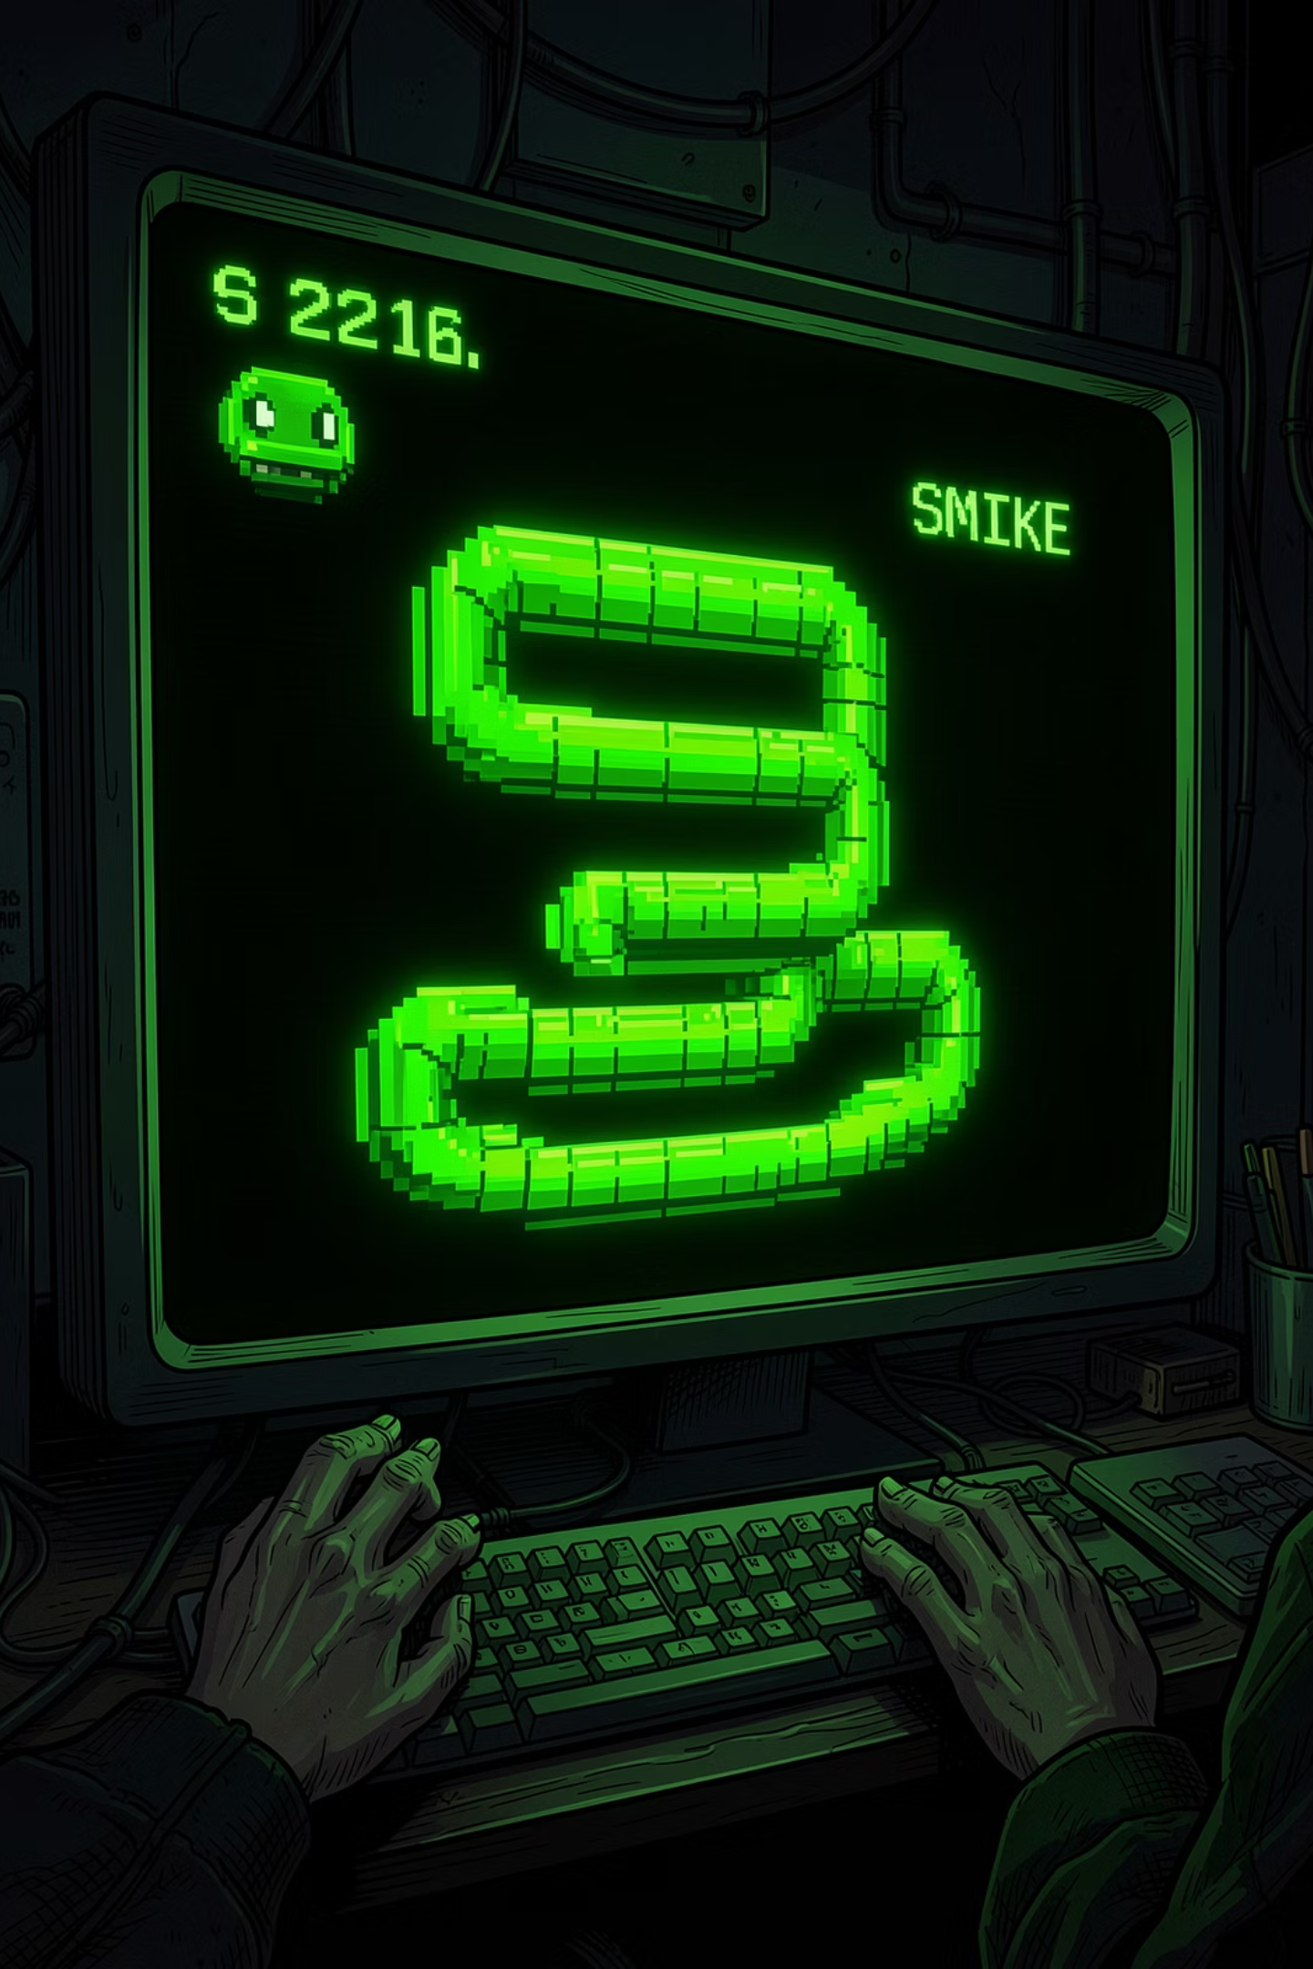
Building Snake in Pygame
A step-by-step walkthrough of a classic arcade game built entirely in Python. This presentation breaks down a working Snake game — from initialising the display to detecting collisions — so you can understand every line of code and build on it yourself.
BEGINNER FRIENDLY
PYGAME
PYTHON

Slide 3
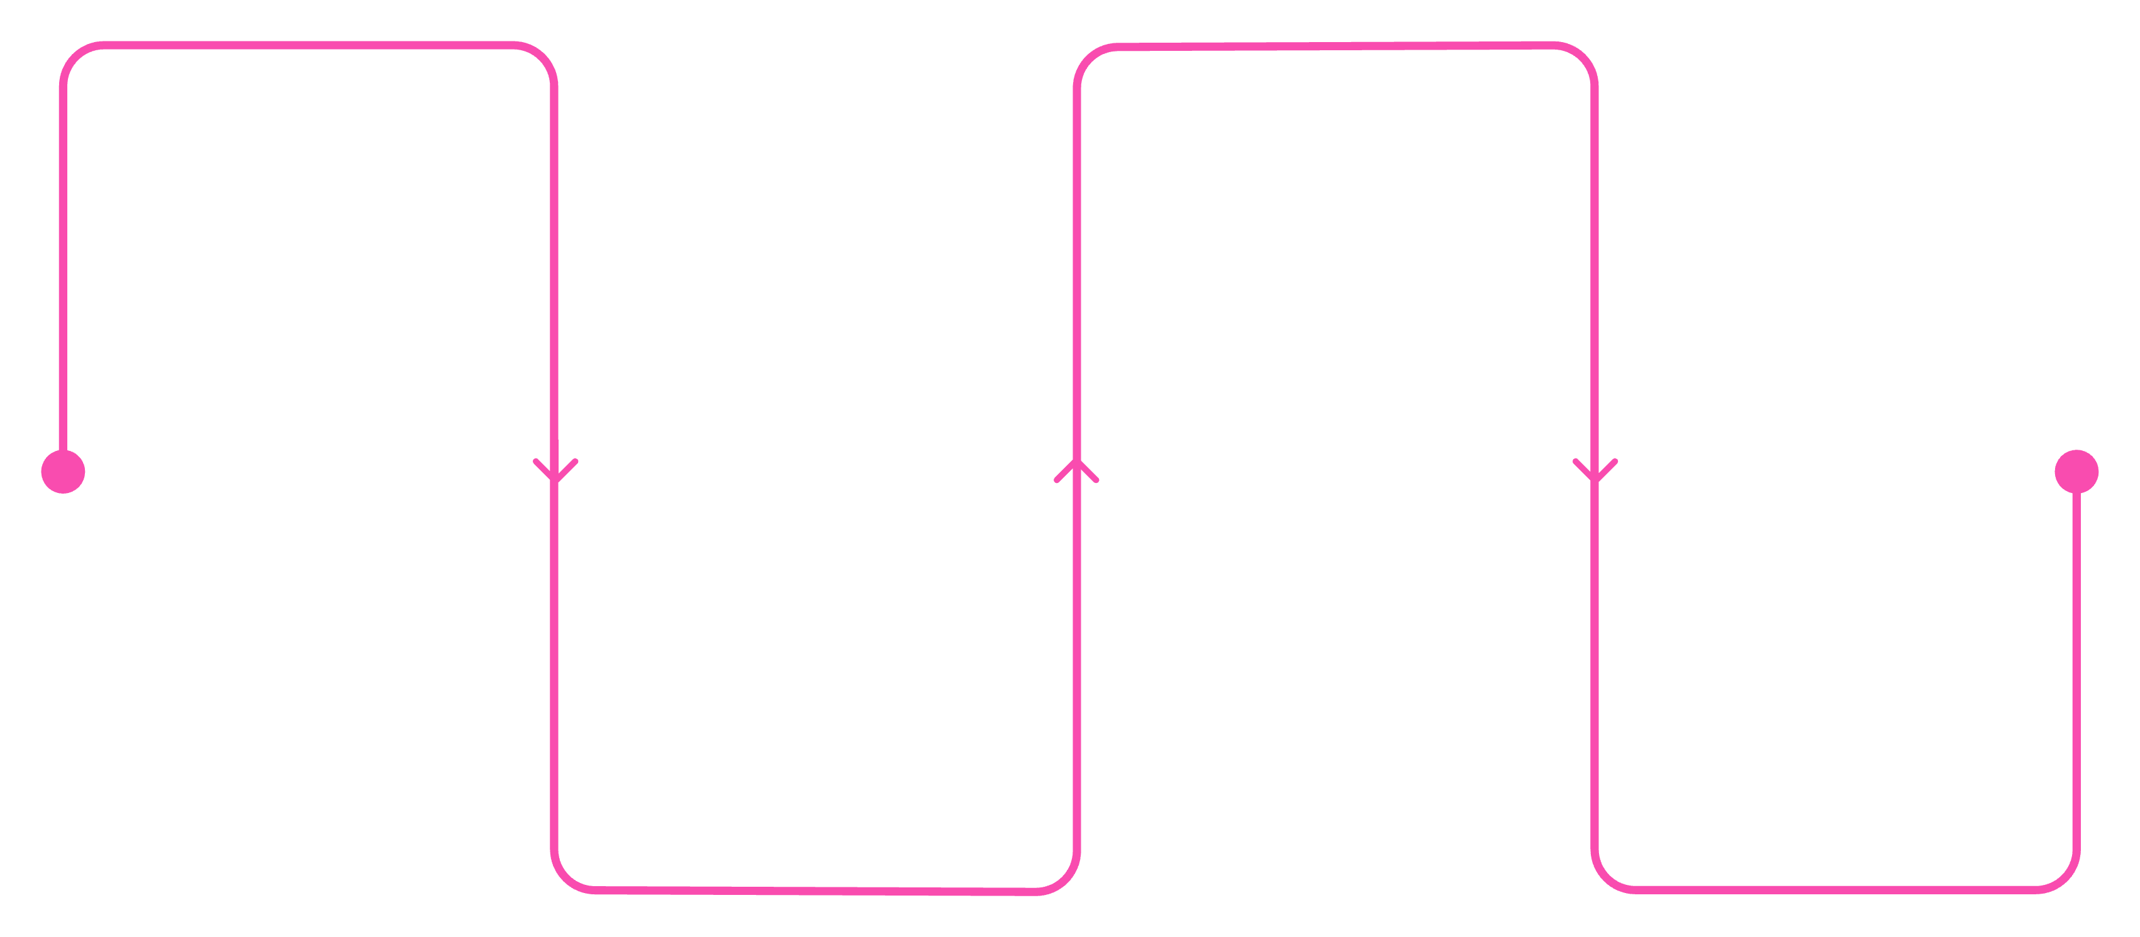
Project Structure at a Glance
Before diving into the details, here is the high-level architecture of the game. Every Snake game needs these four core components working together in a continuous loop.
Initialise
Update State
Set up Pygame, screen, colors, vars
Move snake, check collisions, eat
Handle Events
Draw Frame
Process input and quit events
Clear screen and render snake/food
Understanding this loop is the key to reading any Pygame project. All the logic you'll see in this walkthrough fits neatly into one of these four phases.

Slide 4
Setting Up Pygame
Initialisation & Display
What each line does
pygame.init() — starts all Pygame modules before anything else
set_mode() — creates a 600×400 pixel window
set_caption() — sets the window title bar text
snake_block = 10 — every game element is a 10×10 pixel square
Clock() — controls how fast the game loop runs
import pygame
import random
pygame.init()
width, height = 600, 400
screen = pygame.display.set_mode((width, height))
pygame.display.set_caption("Simple Snake")
snake_block = 10
clock = pygame.time.Clock()

Slide 5
Snake & Food Variables
Snake Position
Snake Body
Food Placement
x = width // 2
y = height // 2
dx = 0
dy = 0
snake = [[x, y]]
length = 1
foodx = random.randrange(
0, width, snake_block)
foody = random.randrange(
0, height, snake_block)
The body is a list of [x, y] pairs. It starts with just the head. The length variable tracks how many segments to keep — it grows by 1 each time food is eaten.
The snake starts at the centre of the screen. dx and dy hold the movement direction — both start at zero so the snake is still until a key is pressed.
randrange with a step of snake_block ensures food always lands on a grid-aligned square, so the snake can collide with it cleanly.

Slide 6

Handling Input & Moving the Snake
Keyboard Events
Updating Position
for event in pygame.event.get():
if event.type == pygame.QUIT:
running = False
elif event.type == pygame.KEYDOWN:
if event.key == pygame.K_LEFT:
dx, dy = -snake_block, 0
elif event.key == pygame.K_RIGHT:
dx, dy = snake_block, 0
elif event.key == pygame.K_UP:
dx, dy = 0, -snake_block
elif event.key == pygame.K_DOWN:
dx, dy = 0, snake_block
x += dx
y += dy
snake.append([x, y])
if len(snake) > length:
snake.pop(0)
Each frame, the new head position is appended to the snake list. If the list is longer than length, the oldest segment is removed with pop(0). This is what creates the trailing body effect.
Note: in Pygame, the Y-axis is flipped — pressing UP decreases Y because (0, 0) is the top-left corner.

Slide 7



Collision Detection
Wall Collision
Self Collision
Eating Food
if x < 0 or x >= width
or y < 0 or y >= height:
running = False
if [x, y] in snake[:-1]:
running = False
if x == foodx and y == foody:
length += 1
foodx = random.randrange(
0, width, snake_block)
foody = random.randrange(
0, height, snake_block)
The head's position is checked against all body segments except the last one (snake[:-1]). Without this slice, the head would always collide with itself.
If the head moves outside the screen boundaries, the game ends immediately. The >= check catches the right and bottom edges correctly.
When the head lands on the food square, length is incremented and new food is spawned at a random grid-aligned position.

Slide 8
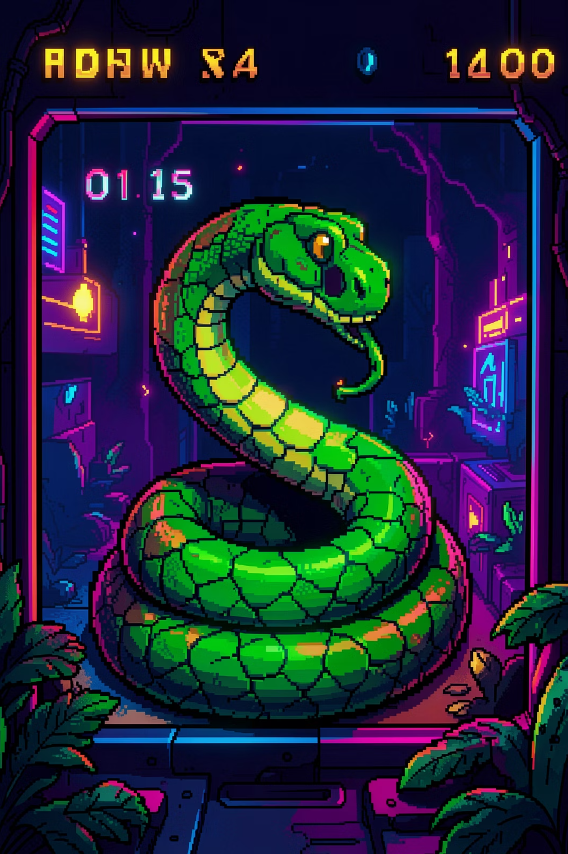

Drawing & Running the Loop
Render & Tick
Key Takeaways
screen.fill(black) clears the previous frame every tick
draw.rect() renders each 10×10 segment — green for the snake, red for food
display.update() pushes the frame to the screen
clock.tick(10) caps the game at 10 frames per second, controlling snake speed
pygame.quit() cleanly shuts down all modules when the loop exits
screen.fill(black)
for part in snake:
pygame.draw.rect(screen, green,
(*part, snake_block, snake_block))
pygame.draw.rect(screen, red,
(foodx, foody, snake_block, snake_block))
pygame.display.update()
clock.tick(10)
pygame.quit()
Try increasing clock.tick() to 15 or 20 to make the snake faster — a great first experiment once the base game is running!

